Slide 1
Why is Language Coding So Bad?
Graeme Williams
carryonwilliams@gmail.com
lagbolt.wordpress.com
Twitter: @lagbolt
Notes:
I approach cataloging questions as a library user, not a librarian. I’m interested in the relationship between catalog records and what is shown on the OPAC page.
I’m also interested in catalog errors. If you’d like help scanning your catalog for errors, let me know. My Python and I are happy to help.

Slide 2
Summary
Where does language (of item) appear in MARC?
Limitations in OPAC searching
Searching for bilingual materials
I’ll use BiblioCommons as an example
Notes:
I’ll spend a couple of slides discussing MARC fields.
OPAC limitations is really a thread that runs through the whole presentation. If you have a complicated situation – for example, a DVD with dialog and subtitles in multiple languages – the catalog record is going to be complicated. And that means that the OPAC is going to have to do something with that complexity – perhaps ignoring it or flattening it. By flattening I mean treating fields with different meaning the same.
Then we’ll discuss how well different searches – simple and advanced – work in practice, in the field.
I’m using BiblioCommons as an example since that’s the OPAC I’ve used most recently, but most OPACs will be similar.

Slide 3
Item language in MARC fields
“Predominant language” in 008 header
041 field:
Dior and I: $afre$aeng$jeng$hfre$jfre$heng
Captain Marvel: $aeng$aspa$afre$jfre$jspa$heng
... Ambiguous (does $a refer to original or dubbed dialog?)
... Not directly visible or searchable by patrons at the subfield level
546 $aIn English, Spanish or French dialogue …
… Potentially useful – but it’s free text
… Not *specifically* searchable by patrons (for most, not all OPACs)
Notes:
The 008 header field includes a three-character code for “predominant language”. That’s a problem for bilingual materials.
It’s possible to code the 008 field as “mul”, but it seems as though no one does it. Bilingual materials are always coded as “eng”, making this field less useful than it could be.
The 041 (“language code”) field is complicated! Here are two contrasting examples from DVDs for two movies.
Dior and I has people speaking both French and English. There are English subtitles for the French and French subtitles for the English.
Captain Marvel is in English, with dubbed dialog in Spanish and French, as well as subtitles translated from English.
But there’s an issue: both original dialog and dubbed dialog are coded in the A subfield.
I have a pop quiz for you: is it always possible to resolve the ambiguity between original and dubbed dialog in the A subfield by looking at the rest of the field?
The 546 (“language note”) field is very useful for displaying information, but less useful for searching, since (a) it’s free text, and (b), it’s not specifically searchable. One exception is Evergreen, which provides direct searching of MARC fields and subfields, but that has other problems.

Slide 4
More MARC fields
Examples from different items …
240 10 $aLargo p©♭talo de mar.$lEnglish
650 0 $aSpanish language materials$xBilingual.
250 $aFirst Spanish edition.
490 1 $aBilingual Stone Arch readers. Nivel/Level 2
830 0 $a39 clues.$lSpanish ;$v5.
Language information in call number (09x field)
Notes:
The 240 (Uniform Title) field can optionally include the language of the item, but I included this example as a reminder that when you’re dealing with other languages, character encoding is a minefield.
This CAN be used in a title search to locate a translated work.
The 650 subject heading is VERY useful – and searchable – in simple cases but doesn’t scale to more complicated cases like DVDs.
The other fields (the 250 edition statement and the series information in the 490 and 830) are useful only occasionally. Honestly, I mainly use them when I’m scanning for errors.
Finally, there CAN be language information in the call number. It’s usual for public libraries to have a “Spanish” collection.

Slide 5
OPAC search limitations
(Using BiblioCommons as an example)
041 is searchable but imperfectly
546 cannot be searched on its own, only with a “keyword” search
“language” means different things in the language facet (uses 008) versus advanced search (uses 041 as well)
Call number is only searchable using an undocumented trick
Notes:
You can use the ‘language’ search term in advanced search to search the 041 (language code) field. But the search engine doesn’t distinguish between original dialog, dubbed dialog or subtitles.
There’s no way, in BiblioCommons at least, to search just the 546 (language note) field. The only search which includes it is a “search everything” keyword search.
And I’ll show you the trick for call numbers in just a moment.

Slide 6
Summary so far
Language information is scattered throughout the MARC record
It can be ambiguous, hard to interpret, or free text
A given field may or may not be (effectively) searchable
And … records are inconsistent and error-prone
Notes:
This is not a criticism of catalogers. Catalogers are working with limited time and resources. Also, cataloging conventions change over time, and there’s certainly no time or money to go back and change old records.

Slide 7
Searching for bilingual materials
I’ll use English + Spanish as an example.
Addresses the use case where families have members who are fluent in different languages
e.g., Parent and child
Real searches would be for particular topics, like “trucks”
So let’s try some searches → → →
Notes:
A real patron won’t necessarily come into the library just looking for “bilingual materials” They’ll be looking for books on trucks or vampires or a Disney character or a Ninja Turtle.
So I’m not looking at a whole patron search – just the part that identifies bilingual results.

Slide 8
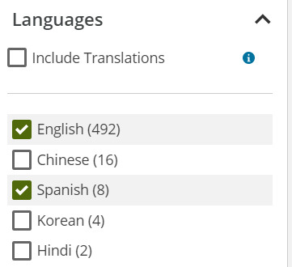
Using the language facet
This means “English OR Spanish”, not “English AND Spanish”
(which wouldn’t work anyway since this ONLY matches the language field in the 008 header)
Notes:
This is a facet on the left-hand side of a search results page. A patron can use this to filter the results.
I don’t think the implied OR is particularly controversial. If you’re buying a t-shirt and you select black, gray and navy blue, that means black OR gray OR navy blue. So the way the language facet works makes sense.
(There’s an extra complication in the “Include Translations” box: with that box checked, the search filter includes the languages in the 041 field. However, I’m skeptical that (a) any patron would understand what this does, and (b) that it’s useful anyway.)
The problem is … this isn’t everything that a patron wants to do with item language. So a patron needs to do something more complicated.

Slide 9

Searches … starting simple
This is an obvious search, but it won’t work very well
It works better than it should because of results ranking
keyword:“English and dubbed Spanish”
Also returns material in Spanish and dubbed English
This searches “everything” not just the language note
subject:spanish bilingual
Doesn’t capture all bilingual materials
Notes:
The first search – in the screen shot – is what a patron might do naturally. It doesn’t quite work, but it also doesn’t quite fail.
I have another pop quiz for you: what does Google do with a search for “spanish english” (no quotes)?
The second search attempts to key on the language note, but there’s no way to search just the language note. Also, searching a free text field is always problematic.
The third search would work fine, except that not all the bilingual material is assigned this subject heading. Cataloger judgement??

Slide 10
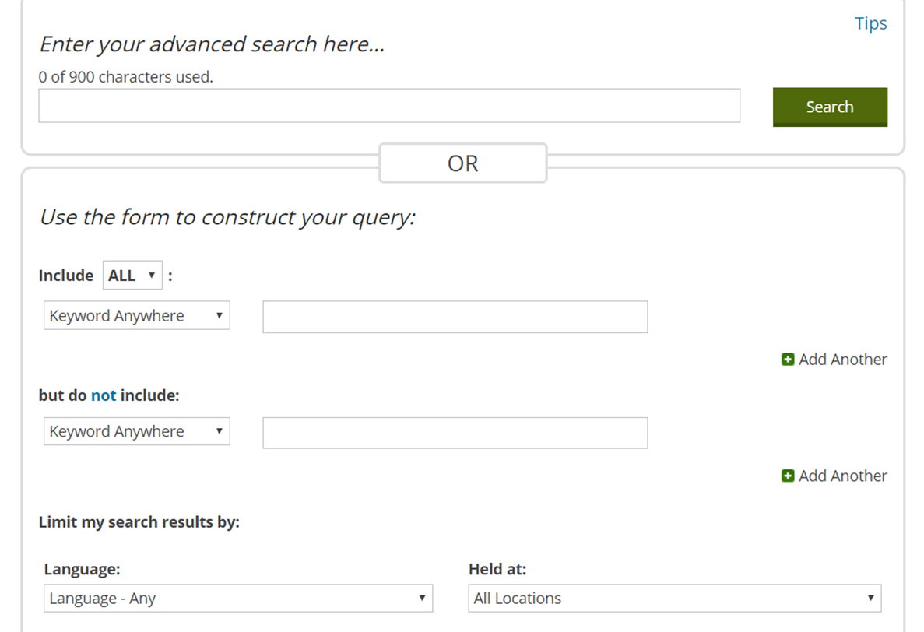
Advanced Search
Notes:
This is a perfectly normal advanced search page, with a weak sort of query builder in the middle of the page.
But, look! Language has been pushed down into a “limit” area, and the pull-down menu strongly suggests that you can only select one language.
So we’ll be using the free text query box at the top of the page.

Slide 11
Advanced Searches
language:eng AND language:spa
Searches both the 008 and 041 field
Works for books but not for movies because ‘language’ includes subtitles
Some bilingual books are missing an 041 field
language:spa ~ with language facet = English
This will catch English movies with Spanish subtitles OR dubbed in Spanish
callnumber:(*spanish*) AND language:eng
Gives approximate but useful results
Accuracy depends on the details of your collection
Notes:
The first search makes perfect sense. You’re looking books in English and Spanish, so you search for English and Spanish. This will work perfectly for books, except some percentage of bilingual books are missing the 041 (language code) field.
It doesn’t work for movies since the search engine doesn’t distinguish between original language, dubbed language or subtitles. It will, for example, return a movie with subtitles in both English and Spanish.
(You can find some records missing an 041 field using the advanced search: callnumber:(*spanish*) AND NOT language:spa)
You do a bit better for movie searches using the language facet, which only keys off the 008 header field, but you still have the ambiguity between dubbing and subtitles.
The last search can be more or less useful depending on your collection. If the patron is searching for a board book on trucks, and you KNOW that all the bilingual board books are in the Spanish collection, this will work perfectly.

Slide 12
“Conclusions”
Most improvements depend on enhancements to the OPAC:
More sophisticated handling of language facet
E.g., “Spanish and English” in addition to “Spanish or English”
Better searching of 041 (e.g., original dialog, dubbed, subtitles)
A specific search on 546
(e.g., languagenote:”Spanish and English”)
AND checking / enhancing many records.

Slide 13
Thank you!
Graeme Williams
carryonwilliams@gmail.com
lagbolt.wordpress.com
Twitter: @lagbolt

